Slide 1
Timing Specification in Little-JIL

Slide 2
Timing specification in Little-JIL
Little-JIL represents a unit of work as a step, and has well defined events that indicate when a step enters one of its states (posted, started, completed). To present the timing constraints on when an event can occur, we developed a single abstraction of timing specification. It has two parts – Deadlines and Delays.
Notes:
Bullets!!!

Slide 3
Deadline/Delay
A deadline is a point in time by which some event must have occurred. The most obvious examples are the completion of some work, but deadlines that specify when some work must have been started are also possible.
A delay is a point in time by which some event must have waited before it can occur.
Notes:
periods

Slide 4
Types of deadlines/delays
Absolute Deadlines/Delays
  are measured from an externally specified point by time (e.g., Sunday, October16, 2011 4:27 EST.)
Relative Deadlines/Delays
  Are measured from the time executed of specified steps going into specified states. Within Little-JIL this point can be:
  The time specified step entering any of its states (posted, started, completed, terminated)

Slide 5
Syntax for absolute deadline/delay
STEPNAME:STATE [ABSOLUTE_DELAYTIME, ABSOLUTE_DEADLINETIME]
  Use path notations to indicate specific steps in processes
  Put the annotation with STEP
Notes:
Stepname is defined using path notation collections where to put --- easy of use

Slide 6
Syntax for relative deadline/delay
STEPNAME1:STATE -> STEPNAME2:STATE [DELAYTIME, DEADLINETIME]
  Entering STEP2.state is the target event we care about
  Time point that entering STEP1:state is where we measure from
  Use path notations to indicate specific steps in processes
  Put the annotation with STEP2
Notes:
Stepname 1… time measurement starts from step1... Step2 terminates stepname1 carefully path notation

Slide 7
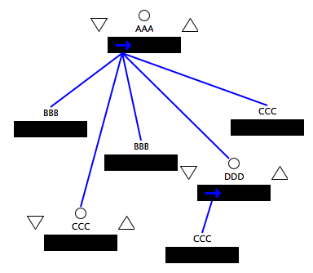
Path Notation in Little-JIL
/AAA - the root step
  We can neglect the first “/” if we select from the root step
AAA/DDD/CCC – all CCC steps which are children of DDD which are children of root AAA
AAA//DDD/CCC – all CCC steps which are children of DDD
Notes:
Single instances vs. multiple instances second and third examples are same!!! define

Slide 8
Path Notation in Little-JIL
AAA/BBB[1] – the first BBB substep of root AAA
AAA/BBB[last()] – the last BBB substep of root AAA
AAA//BBB[2] – the second BBB descendant of AAA (DFS search)
Example: the started state of second CCC step is
AAA//CCC[2]:started
Notes:
A

Slide 9
Extension of Path Notation
. - current step
.. - parent of current step
For the substep CCC of DDD, ../../CCC[2] refers to the right most CCC step
For DDD step, ../BBB[1] refers to its first BBB sibling

Slide 10
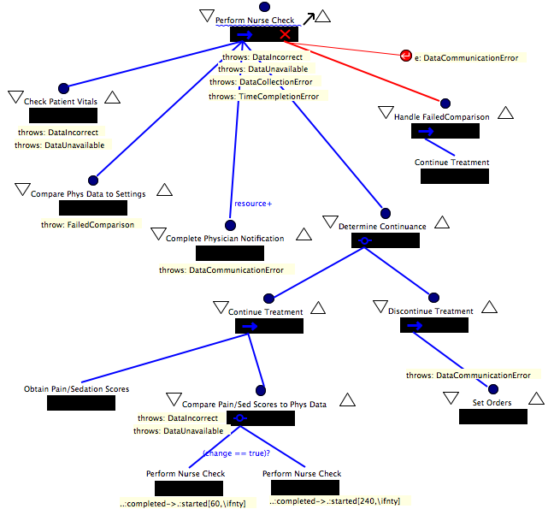
Example 1 – infusion process
Notes:
Change!!

Slide 11
Example1 - infusion process
Timing constraints description:
  After infusion therapy starts, the nurse should perform several rounds of checks on patient. At the end of each round of checks, the nurse compares the Pain/Sedation scores with Patient’s physical data to determine when to do the next round.
  If (change == false), the nurse should wait at least 60 time units before performing another check. If(change == true), the nurse should wait at least 240 time units.

Slide 12
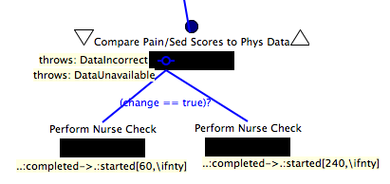
Example 1 – infusion therapy
Notes:
Change the process

Slide 13
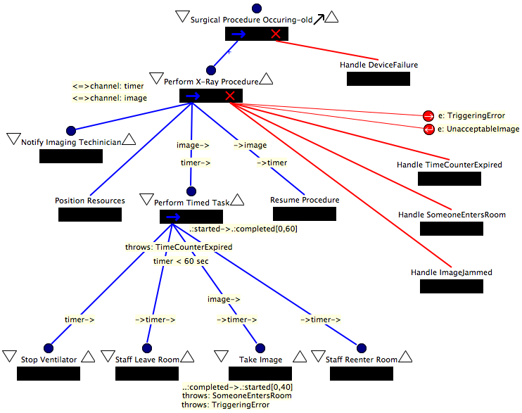
Example 2 – X-ray ventilator
Notes:
delete

Slide 14
Example 2 – X-ray ventilator
Timing constraints description:
  “Perform timed task” step has to be finished in 60 time units.
  “Take image”, a substep of “Perform timed task” has to be started in less than 40 time units after “Perform timed task” is started.

Slide 15
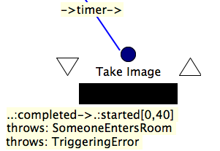
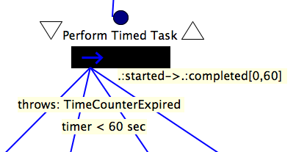
Example 2 – X-ray ventilator
Timing constrains #1
Timing constraint #2
Notes:
Error!

Slide 16
Possible uses of timing specifications
Little-JIL process with timing specifications might be translated to network of time automata and then be analyzed by some model checker like Uppaal.
Deadlines can be used by the resource manager to establish upper bounds on the utilization of a resource for scheduling. (previously done by our lab but not fully implemented)
Notes:
1. Define the semantics of execution.

Slide 17
End

Slide 18
Some interesting topics
1. The bound of timing specification.
  In addition to the actual work of the step, the execution of a Little-JIL step includes resource acquisition, the evaluation of the pre- and post-requisites for the step and the execution any exception handlers specified in the step. Whether to include this work in the work bounded by the deadline probably depends on the work being done in these parts of the step, and the nature of the deadline.
  We assume the process programmer will use the Little-JIL decomposition mechanism in cases where they want to control which parts of a step are included in or excluded from the deadline/delay.

Slide 19
Some interesting topics cont.
2. How to handle timing constraints involving exceptions.
  a. continuing badge: Step is completed when exception is thrown.
  b. completing badge: Step is completed when exception is thrown.
  c. If the exception handler is not a simple badge but some steps, we can treat them like normal process.

Slide 20
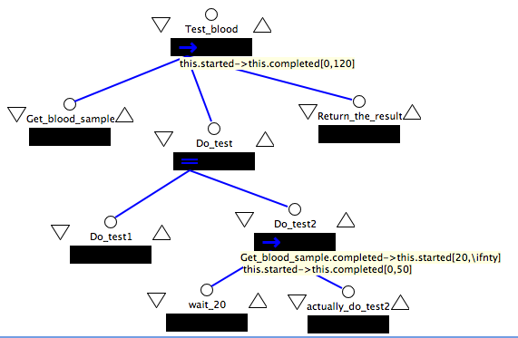
Some interesting topics cont.
2. deadlines/delays vs. wait step

Slide 21
Some interesting topics cont.
Since every step will has an agent in little-jil process. The resource manager will assign an agent to do “wait” step and this agent actually do nothing there.
With the delay specification, resource manager will assign the agent after 20 time units thus no resource will be wasted.

Slide 22
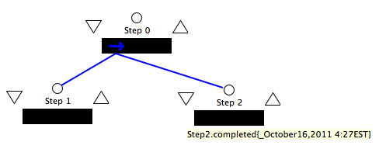
Absolute deadlines
Step2 has to be completed before October16, 2011 4:27 EST.
Noted the underscore before absolute time “October16, 2011 4:27 EST”.

Slide 23
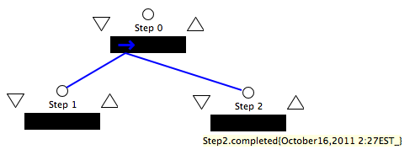
Absolute delays
Step2 has to be completed after October16, 2011 2:27 EST.
Noted the underscore after absolute time “October16, 2011 2:27 EST”

Slide 24
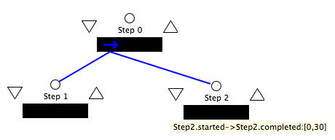
Relative deadlines
Step2 has to be completed in 30 time units after Step2 has started.
It means that the execution time of Step2 has to be equal or less that 30 time unites.

Slide 25
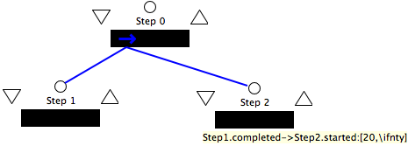
Relative delays
Before Step2 can start, it has to wait at least 20 time units measured from Step is completed.
It means that the delay time of Step2 has to be equal or greater that 20 time unites.

